Slide 1
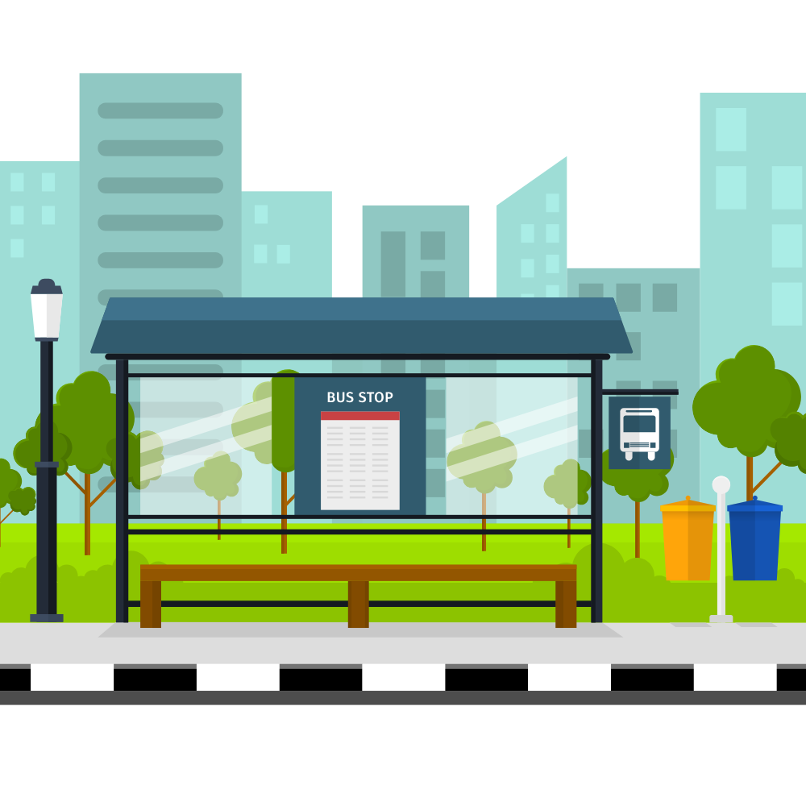

e-Conductor
Group 09
(Next Level of Sri Lankan Public Transport)
Department of Computer Engineering
Faculty of Engineering
University of Peradeniya
Sri Lanka

Slide 2
e-Conductor
Group 09
(Next Level of Sri Lankan Public Transport)
Department of Computer Engineering
Faculty of Engineering
University of Peradeniya
Sri Lanka

Slide 3



OUR TEAM
THE PROBLEM
EXISTING SOLUTIONS ?
OUR SOLUTION
OUR PLAN
e-Conductor

Slide 4


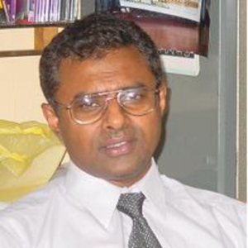
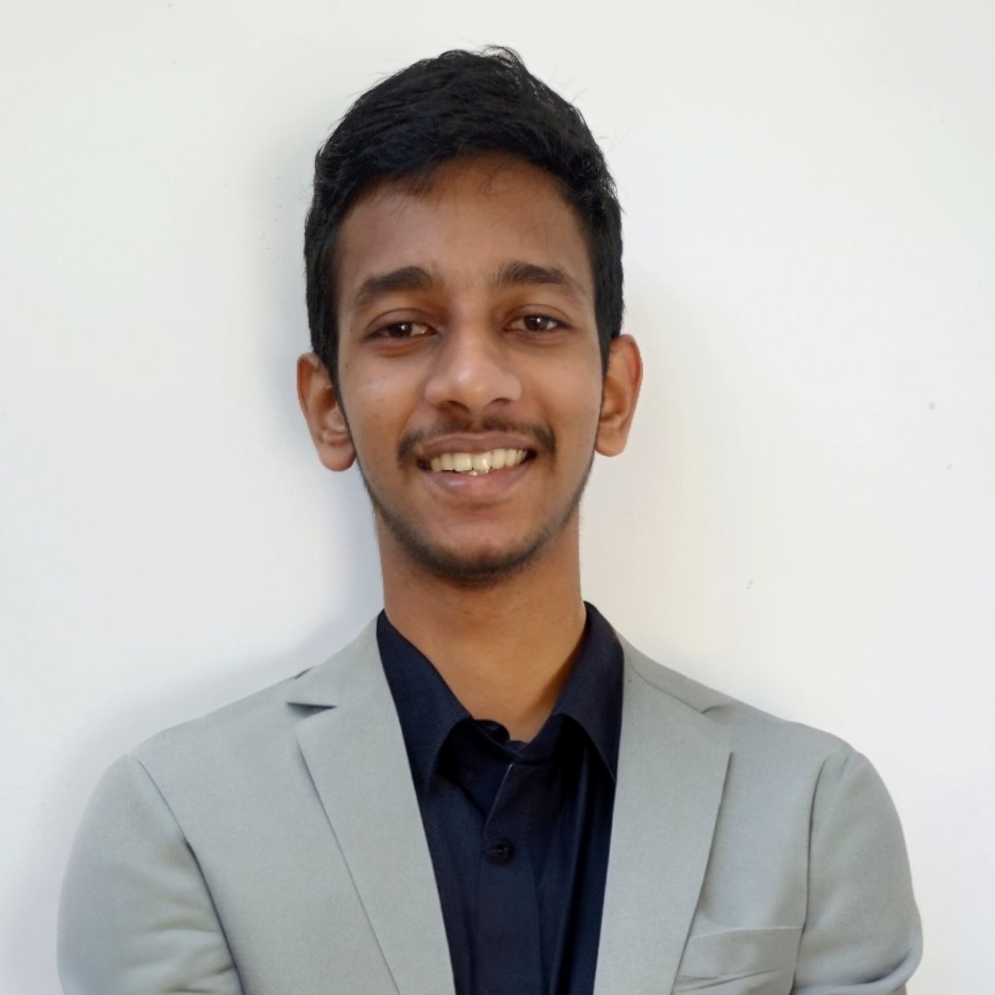
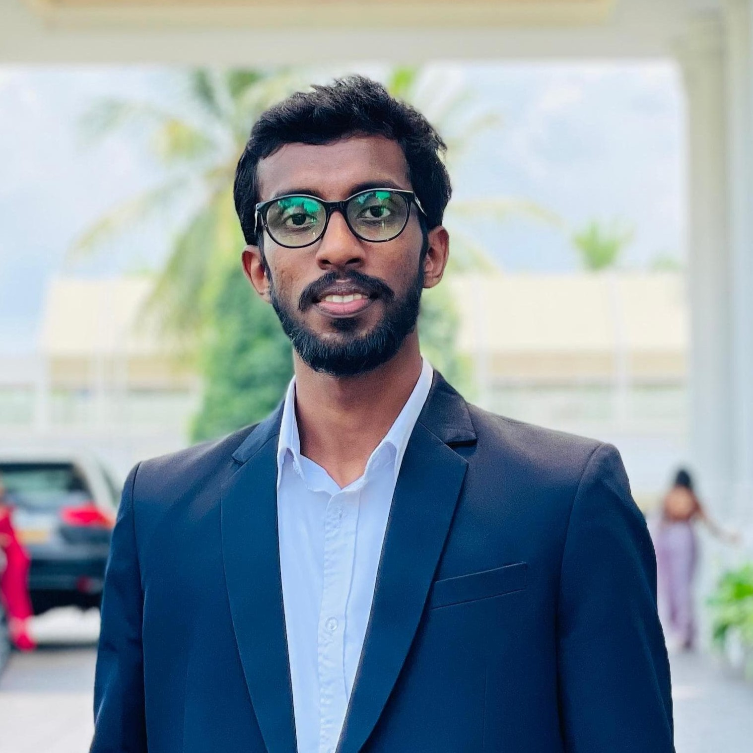
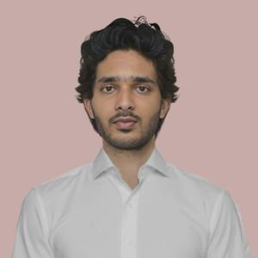
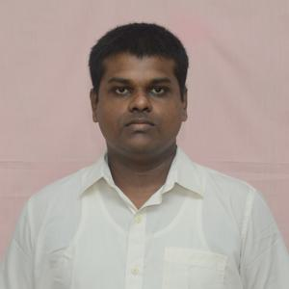
OUR TEAM
SUPERVISOR
Prof. Manjula Sandirigama
E/20/032
Bandara A.M.N.C.
E/20/035
Bandara K.C.H.N.A.W.M.R.C.J.N.
E/20/133 Haththella H.A.D.T.N.
E/20/157
Janakantha S.M.B.G.

Slide 5
OUR TEAM
THE PROBLEM
EXISTING SOLUTIONS ?
OUR SOLUTION
OUR PLAN
e-Conductor

Slide 6
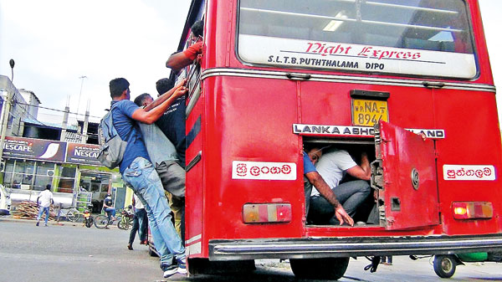
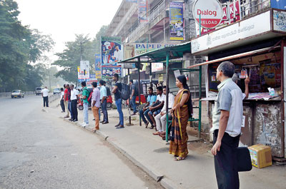
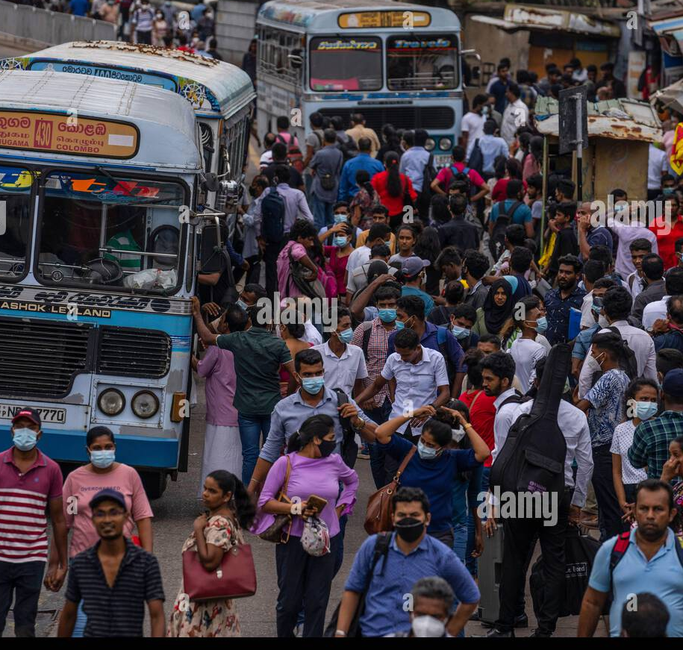

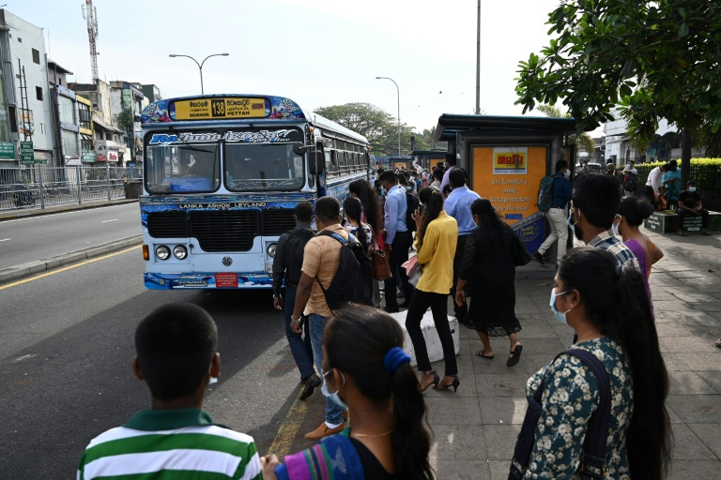


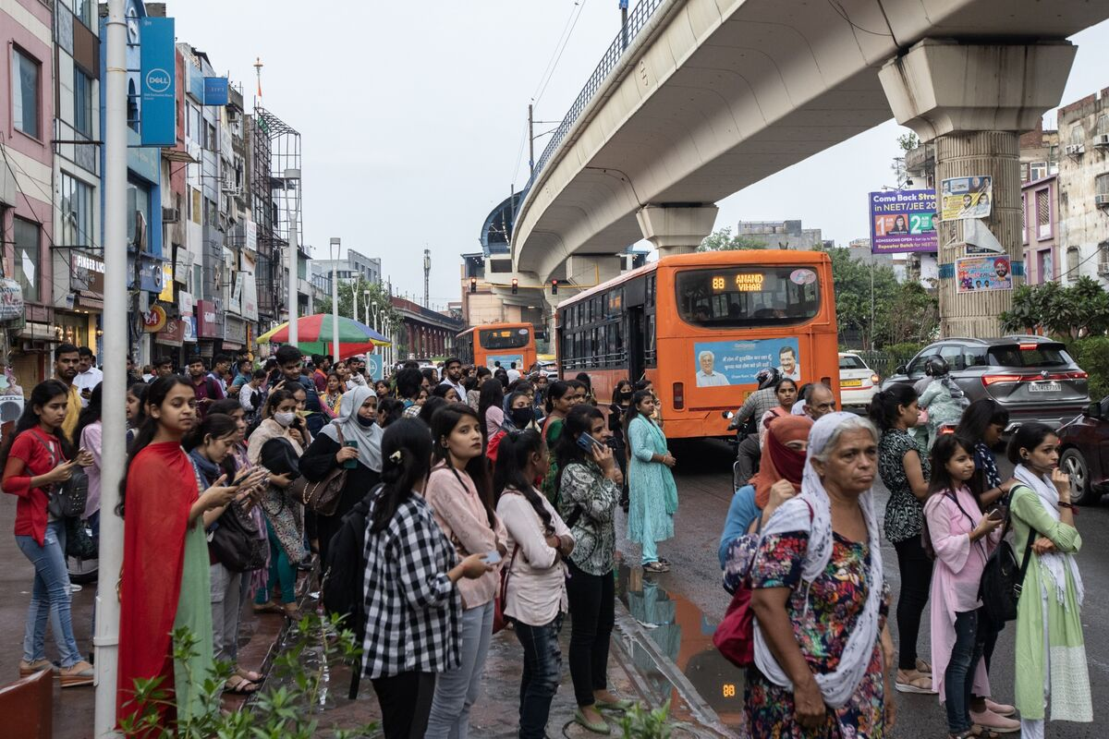

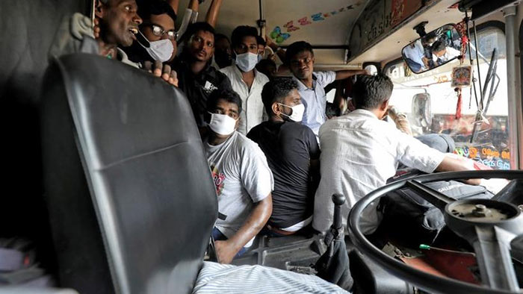

THE PROBLEM
Waiting in long queues
No method to find availability of busses
Overcrowded busses
Issues on getting balance
Shifting from public transport

Slide 7
OUR TEAM
THE PROBLEM
EXISTING SOLUTIONS ?
OUR SOLUTION
OUR PLAN
e-Conductor

Slide 8
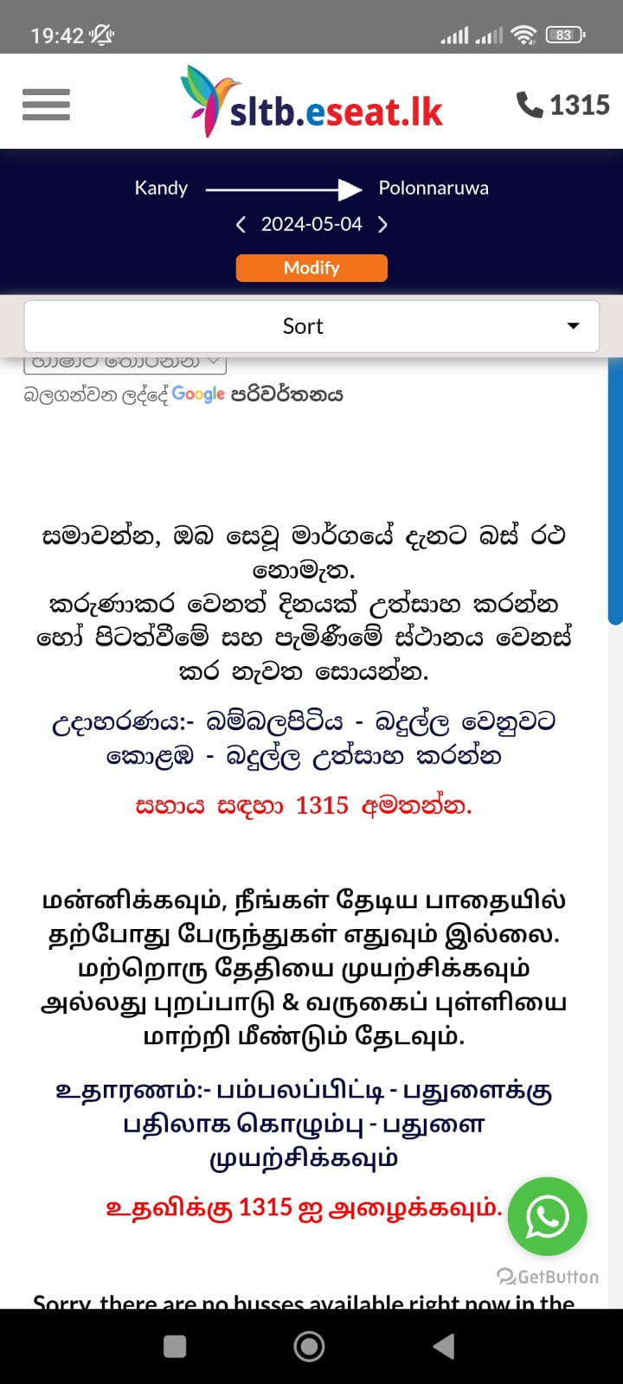
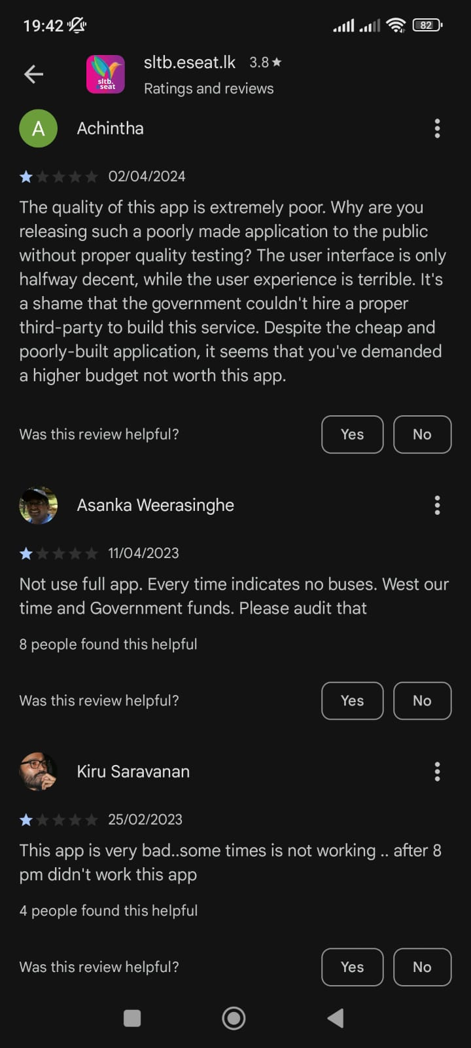

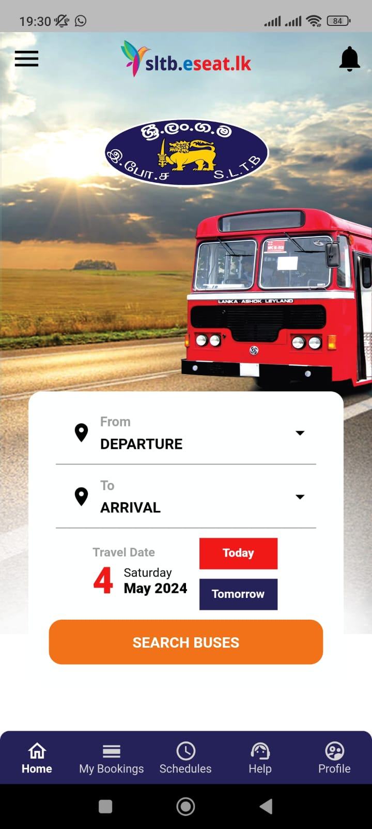

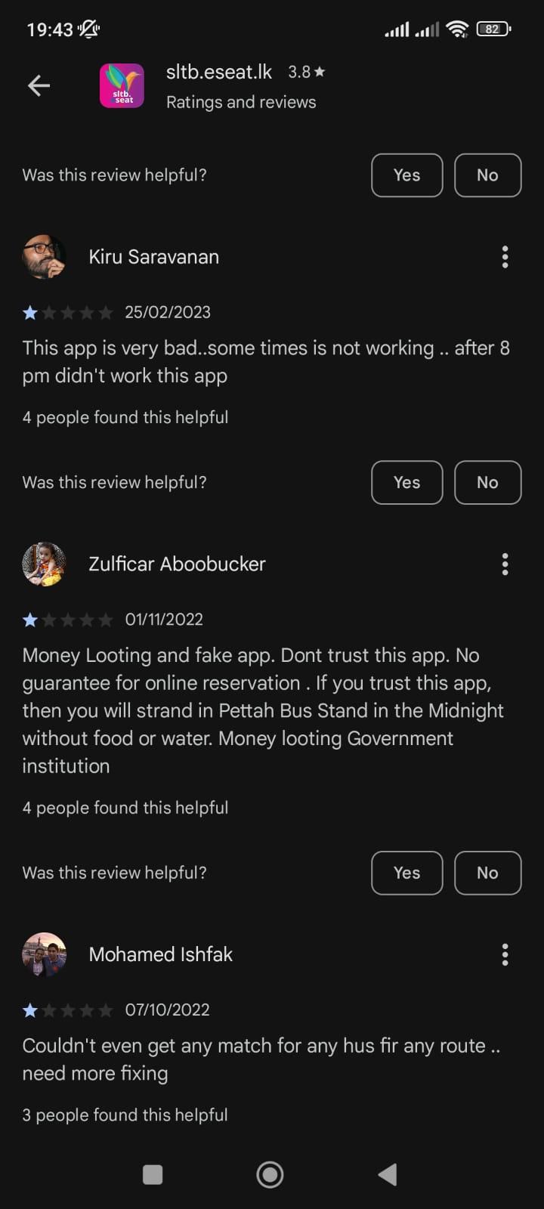


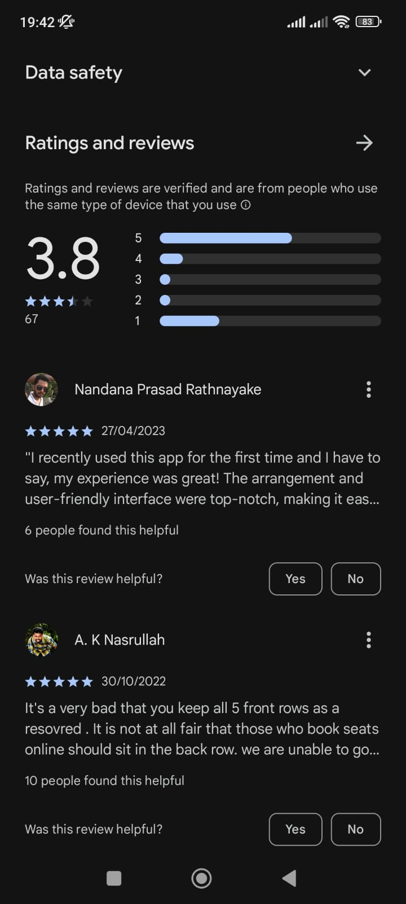

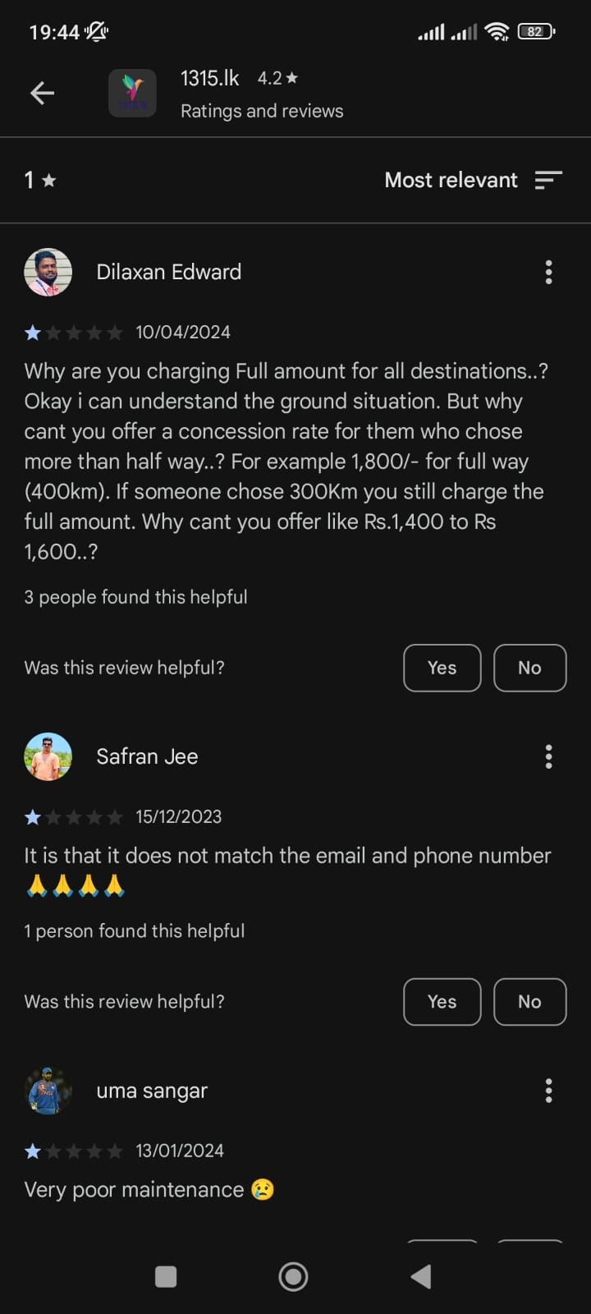

EXISTING SOLUTIONS ?
No method for tracking busses
Payment and booking are not guaranteed
Contact details are not available
Schedules are outdated
No Methods for complaints

Slide 9
OUR TEAM
THE PROBLEM
EXISTING SOLUTIONS ?
OUR SOLUTION
OUR PLAN
e-Conductor

Slide 10





OUR SOLUTION
Online seat reservation facility
Online schedule checking facility
Realtime location tracking facility
Digital transaction facility
Customer care service

Slide 11
OUR TEAM
THE PROBLEM
EXISTING SOLUTIONS ?
OUR SOLUTION
OUR PLAN
e-Conductor

Slide 12







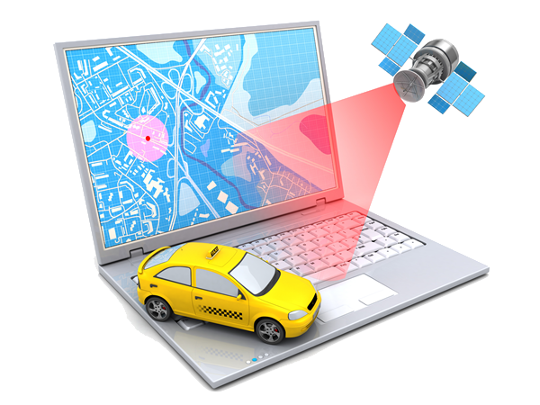
OUR PLAN
Web App
Mobile App
Database
Testing & Debugging
Payment Gateway
App Launching
Suggestion Algorithm
Live Location Tracking
Notes:
Further implementation: Extend to normal routes, Merge train App

Slide 13
OUR TEAM
THE PROBLEM
EXISTING SOLUTIONS ?
OUR SOLUTION
OUR PLAN
e-Conductor

Slide 14
THANK YOU

